Slide 1
The Social Network
Muhammad Hassan Khalid 21L-5692
Muhammad Hamza 21L-5636

Slide 2

Abridged Story
Skills
Practical Advice
Outline
Exercises
Conclusion

Slide 3
Abridged Version of Story

Slide 4
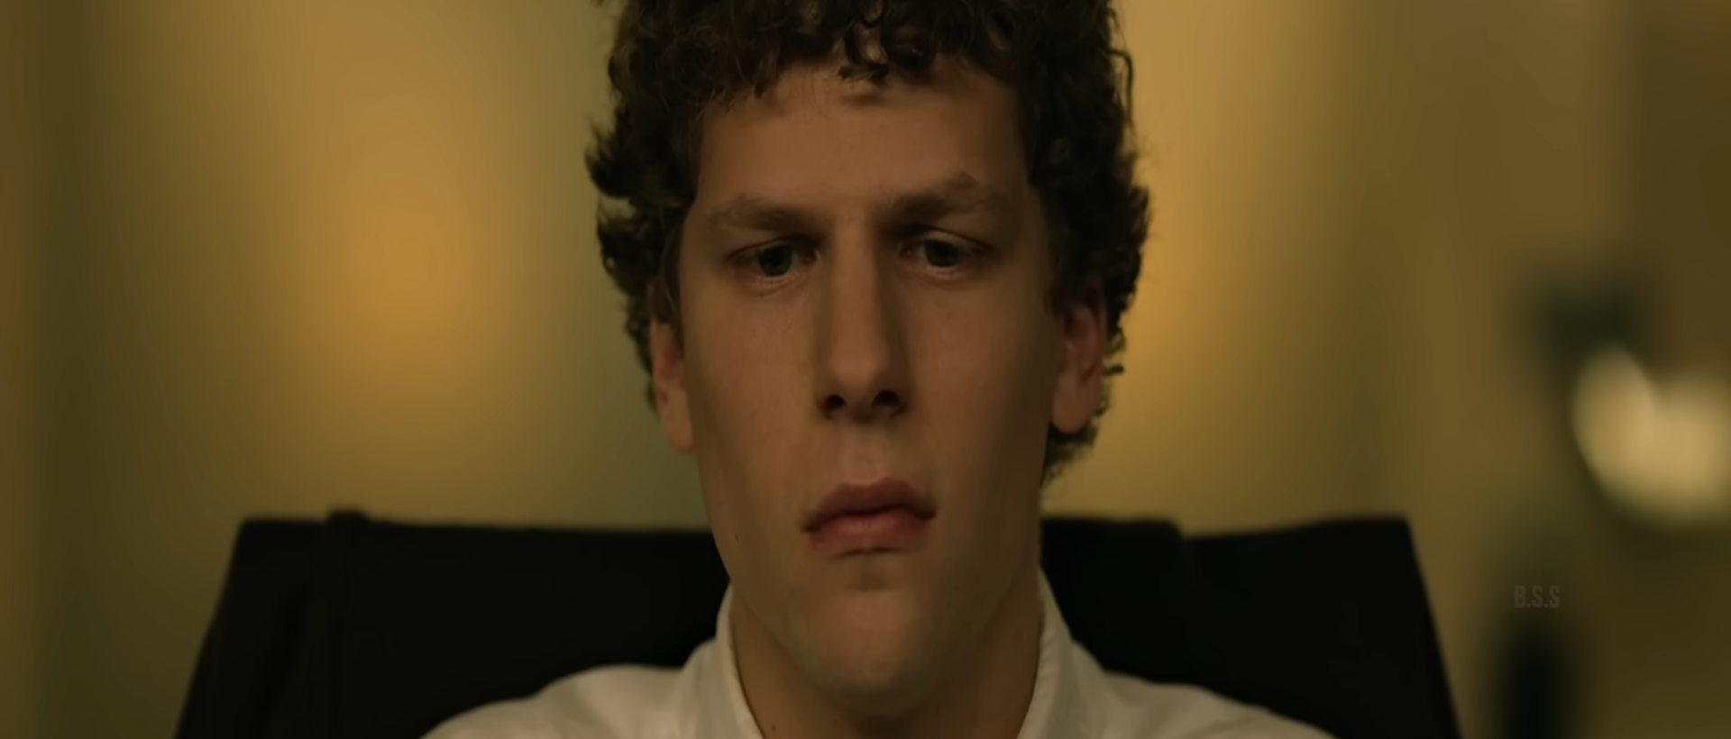
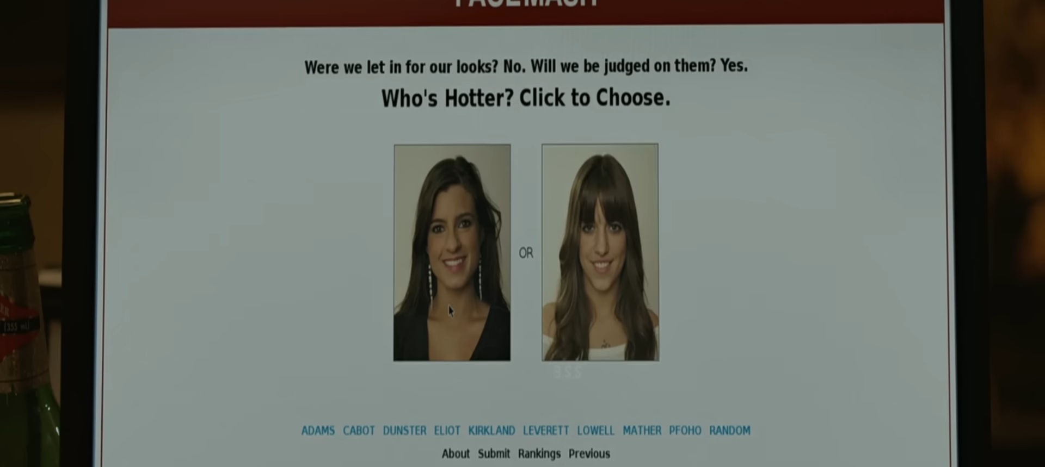
Mark Zuckerberg, a socially awkward yet brilliant Harvard student, creates "FaceMash," sparking controversy and crashing Harvard's network.

Slide 5

Captures attention of the Winklevoss twins, who hire Zuckerberg to build their social network idea.

Slide 6
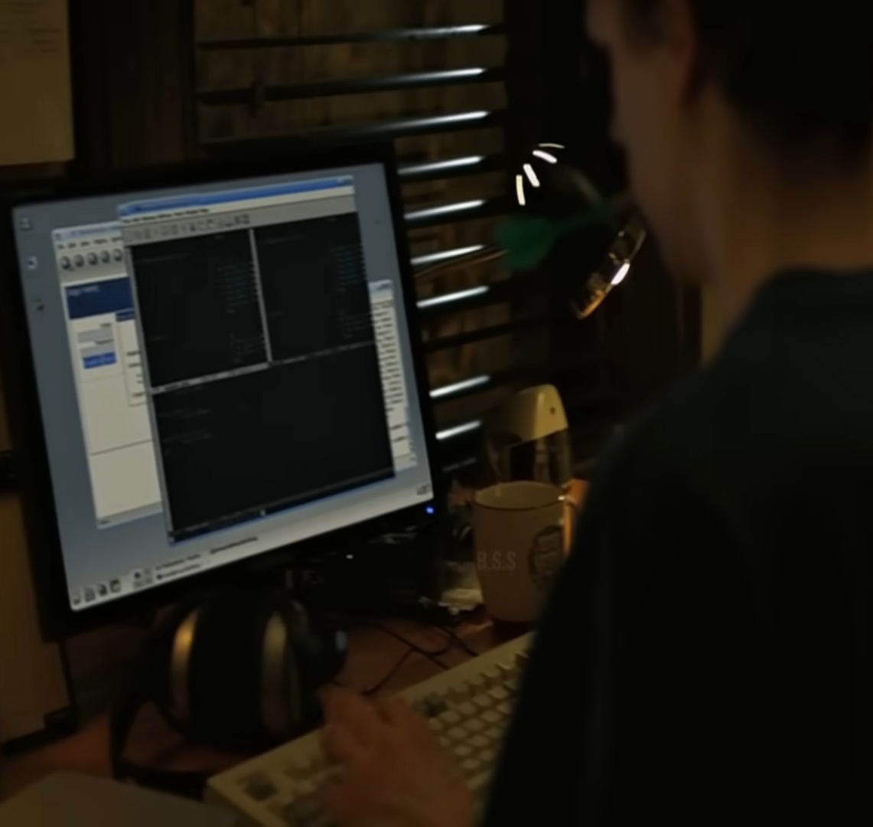
Instead, Zuckerberg develops his own version, "The Facebook," for Harvard students, later expanding to Ivy League schools.

Slide 7


Partner Eduardo Saverin funds the project; Sean Parker's guidance helps scale it globally.

Slide 8
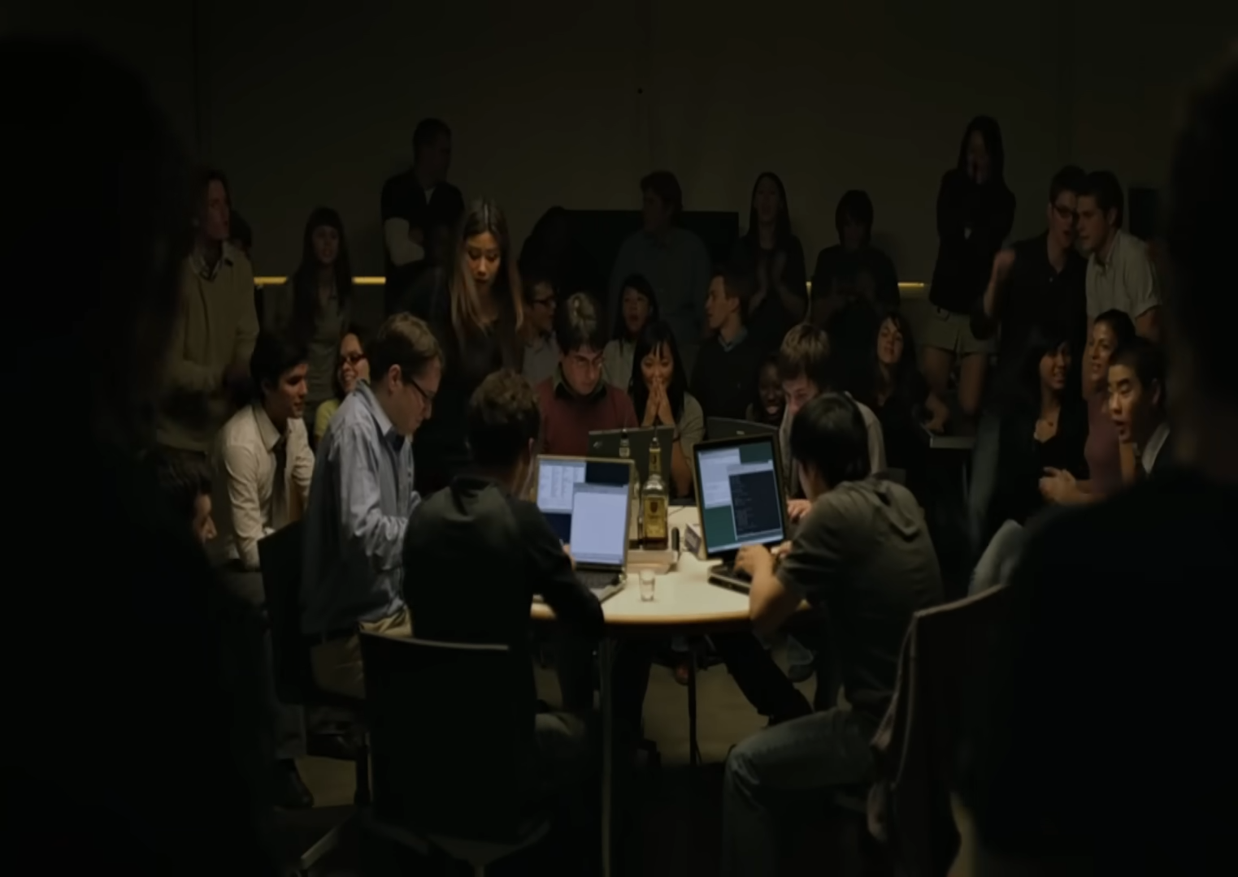
Zuckerberg moves to California, leading to a rift with Saverin, who is eventually sidelined.

Slide 9
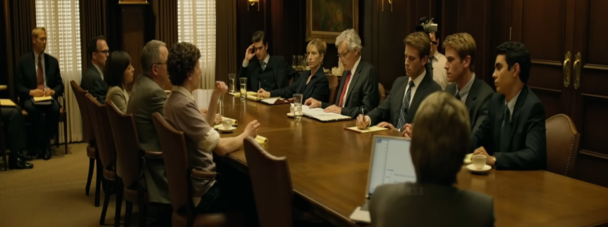
Facebook's rapid growth brings lawsuits from the Winklevoss twins and Saverin, highlighting Zuckerberg's ruthless ambition.

Slide 10
Skills with Significant Contribution
Solved complex problems by organizing user profiles, friend lists, and designing efficient algorithms to handle rapid user growth.
Saw the gap in online social connection, creating an interactive platform with unique features like News Feed.
Analytical
Thinking
Creative
Thinking
Wrote most of the initial code himself, building user-friendly and scalable features.
Overcame legal disputes, team conflicts, and investor pressures; adapted to rapid growth and challenges, ensuring Facebook’s continuous expansion.
Resilience
Flexibility
Agility
Technological
Literacy

Slide 11
Analytical Thinking
Activity:
Engage in data analysis and logic puzzles.
Participate in coding challenges on platforms like Kaggle.
Exercise:
Break down real-world problems (e.g., social media trends).
Solve chess or math puzzles for logical reasoning.
Creative Thinking
Activity:
Organize brainstorming sessions for innovative problem-solving.
Engage in creative hobbies (writing, painting, design workshops).
Exercise:
Conduct idea sprints for unique solutions.
Challenge assumptions with "What if" scenarios.
Advice
&
exercises

Slide 12
Technological Literacy
Activity:
Join coding boot camps or online courses (Coursera, edX).
Work on hands-on coding projects (websites, apps, AI models).
Exercise:
Build a small application or website using Python or JavaScript.
Resilience, Flexibility, and Agility
Activity:
Organize group activities with tight deadlines to simulate real-world challenges.
Exercise:
Practice mindfulness through yoga, meditation, or journaling.
Reflect on challenges to develop self-awareness and adaptability
Advice
&
exercises

Slide 13
The journey of Mark Zuckerberg in The Social Network illustrates the pivotal role of essential skills such as analytical thinking, creative thinking, technological literacy, and resilience in achieving success. Through his innovative approach, Zuckerberg transformed a simple idea into a global phenomenon, demonstrating that a combination of technical expertise and adaptive problem-solving is crucial in the fast-paced world of technology
Conclusion

Slide 14

thank you!

